Slide 1
IEO – week 4

Slide 2
This week
What is an OS?
What does the OS do?
Notes:
Applies to al electronic devices?

Slide 3

How does it work?
CPU
OS
?
I/O hardware
Application
Memory

Slide 4
It works like this
Application
OS
CPU
I/O hardware
Memory
Notes:
User always interactis via the I/O hardware!

Slide 5
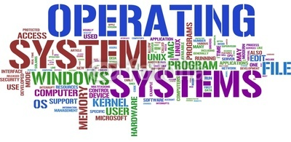
What is an OS?
Operating System
Collection of system software:
Manage hardware & applications
Layer between hardware & applications
Maintain system integrity & error handling
Not all ‘computers’ have an OS
Ex. Micowave, dishwasher, etc.
Notes:
Your computers operating system (OS) manages all of the software and hardware on the computer. Most of the time, there are many different computer programs running at the same time, and they all need to access your computers central processing unit (CPU), memory, and storage. The operating system coordinates all of this to make sure each program gets what it needs. Basically it’s a layer between the applications and hardware
Not all computers have operating systems. The computer that controls the microwave oven in your kitchen, for example, doesn't need an operating system. It has one set of tasks to perform, very straightforward input to expect (a numbered keypad and a few pre-set buttons) and simple, never-changing hardware to control. For a computer like this, an operating system would be unnecessary baggage, driving up the development and manufacturing costs significantly and adding complexity where none is required. Instead, the computer in a microwave oven simply runs a single hard-wired program all the time.

Slide 6
OS - History
Long long ago: No OS
(Usually) One application
Long ago: Simple OS
Multiple application, but on at a time
Present time: Complex OS
Multiple application & multiple at the same time
Notes:
https://en.wikipedia.org/wiki/History_of_operating_systems

Slide 7

OS - Characteristics
Single or multiple ‘computers’
Single- or multi-tasking
Single- or multi-user
Specific or general hardware
User Interface
Notes:
When looking at an OS we can see a few charactertics. The ones mentioned here are just a selection
OS that runs on one computer, but also one on multiple ones also called ‘Distibuted OS’
Possiblilty to run one or multiple applications at the ‘same’ time
Possibility to have one or multiple concurrent users
If it’s specific for a type of hardware or not
If it has a UI; GUI or command line

Slide 8
Complex / modern OS
Notes:
This course we’re going to focus on modern OS’s

Slide 9






Examples
Notes:
The OSs above are popular ones you can find in modern computers. Some of the mentioned characteristics are also found in these OS’s:
Multitasking
Single computer
‘General’ hardware; iOS and OS X require Apple hardware
All have a GUI (command line is possible by most)

Slide 10
OS - Tasks
What does the OS do?
Interrupt handling
File management
Proces management
Memory management
Resource management
I/O management
In depth look
Notes:
NOTE: This gives you a general idea of what that task does. The details are different per OS!
Interrupt handling: Mechanic to interrupt a process to do something else. (https://en.wikipedia.org/wiki/Interrupt_handler)
File management (file system): The way data is stored (also permission and such) (https://en.wikipedia.org/wiki/File_system)

Slide 11
What happens when we have multiple applications running?
Process management

Slide 12
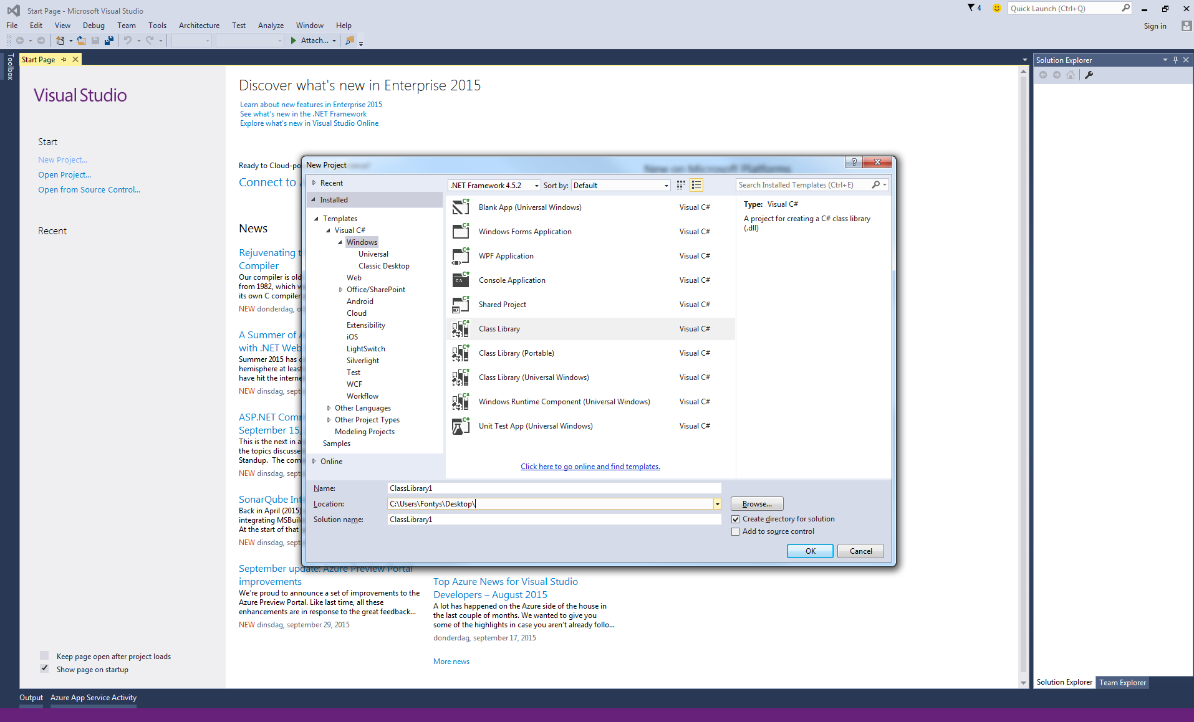
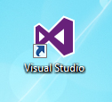
Starting an application
?
What is actually happening?
Start application
(double click shortcut)
OS
Process
Thread(s)
Notes:
What happens when you start an application.
We double click (in Windows) and then an application is shown, but there is actually more happening
When we start an application the OS creates a process which represents the application running
Besides a process there will also be thread(s) running which are part of a process.

Slide 13
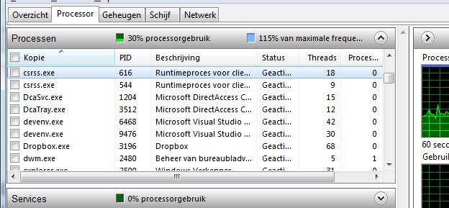
Processes
Operating system enables this by
Multi tasking / Time sharing / Process management
Within a second every process gets some time to run. Because a computer is so fast it seems like it simultanious
Game
Torrent
Music
Voice chat
Game
time
Process represents an application
Multiple applications with 1 CPU:
Playing a game
Downloading legal content (BitTorrent)
Listening to music
Voice chat
Etc.
How is this possible?
Notes:
Starting multiple applications means the OS is creating a process per application started
Even though it seems they are running at the same tim in reality only 1 process runs per CPU
If we only have 1 CPU the OS switches very fast between the processes
The time a process get to run on the CPU is called time slice. When the OS switches between processes we call it Context switching.
This principle is part of a multitasking OS which uses preemptive switching. The OS forces the processes to switch

Slide 14
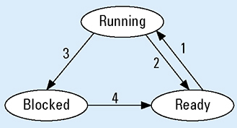
OS – Process scheduling
What if the download is done?
Wasted CPU time
Solution: process state
Game
Torrent
Music
Voice chat
Game
time
1: Scheduler picks this process
2: Scheduler picks another process
3: Process blocks for input
4: Input becomes available
Notes:
Because we don’t want to waste CPU time, a process also has a state. This state indicates if the process will get any CPU time.
When blocked it usually means that the process is waiting on something. This can be another process or user input.

Slide 15
OS – Process scheduling
Some processes are more important:
+ Playing a game
– Downloading legal content (BitTorrent)
Solution: Process priority
Game
Voice chat
Game
Torrent
Game
time
Notes:
Not all processes are equally important. To solve this problem a process can also have a priority;
Higher priority processes gets more and ?Longer? time slices
Linux: Dynamicly determened. Very complex algorithm

Slide 16
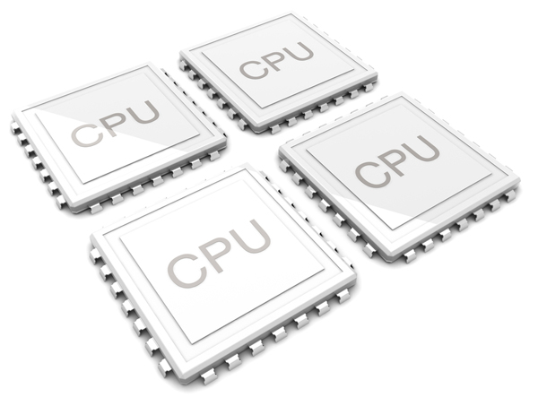
Multiple ‘cores’
Core 1
Voice chat
Music
Voice chat
Music
Voice chat
time
Core 2
IP tv
Torrent
IP tv
Torrent
IP tv
time
…..
Core N
Game
Game
Game
Game
Game
time
Modern processors
Multiple cores
OS splist proccesses between cores
Notes:
Of course almost all modern CPU’s are multicore and this means processes are running at the same time per core

Slide 17
What happens with the data when there is a context switch?
Memory management

Slide 18
Memory usage
Program code like:
int numberA = Convert.ToInt32(tbNumberA.Text);
MyClass myObj = new MyClass();
and the application self uses volatile memory (RAM)
Amount of RAM needed = N_{Visual Studio} + N_{Word} + N_{Chrome} + …
> available RAM?
Solution: Buy more RAM
Cheaper solution: Let the OS handle this!
OS determines who can access which part of the RAM & uses a ‘trick’ called virtual memory
Notes:
Whenever we do something with data in an application RAM memory is being used.
At some point our active application will require more memory then there’s available!
One way to solve this is by throwing money at it and buy more RAM! But there is a more money friendly way.
Let the OS handle this. The OS will use a ‘trick’ called virtual memory

Slide 19
OS – Memory management
Multiple applications running
Where is ‘my’ data?
What happens when:
Save data to memory
Start a new application
Solution: OS handles memory allocation
Memory
Voice chat app.
Music app.
Game data
Voice chat data
Torrent app.
Browser app.
IP tv data
Game app.
Torrent data
IP tv app.
Notes:
To illustrate how memory allocation works: an application doesn’t know where there is memory available. Overwitting each other is not ideal!

Slide 20
OS - Memory management
I want to save data
Voice chat application
OS
CPU
Memory
Virtual address
Voice chat app.
Music app.
MMU
Game data
Page table
Game data | xxx
Torrent app. | yyy
Voice chat data | zzz
Etc.
Torrent app.
Voice chat data
IP tv data
Game app.
Torrent data
IP tv app.
Physical address
memory bus
Notes:
Application asks the OS for memory
OS asks the CPU which uses a MMU to see where its located in the physical memory
Memory Management Unit
Translate virtual addresses to physical addresses
https://en.wikipedia.org/wiki/Memory_management_unit

Slide 21
Overusing memory
What if I start a browser when the memory is full?
Remember context switching?
OS ‘swaps’ process from RAM to storage
Solution: Virtual memory

Slide 22
Simplified diagram
Game
Browser
time
OS
Memory
Voice chat app.
HDD
Music app.
Game data
IP tv app.
Torrent app. & data
Voice chat data
IP tv data
Game app.
Browser app.
Torrent data
Torrent app.
Notes:
1 Game is running
2 User starts a broswer
3 OS swaps torrent data from RAM to HDD
4 OS loads browser into RAM

Slide 23
Simplified diagram
Game
Browser
Game
time
OS
Memory
Voice chat app.
HDD
Music app.
Game data
IP tv app.
Torrent app. & data
Voice chat data
IP tv data
Game app.
Browser app.
Notes:
1 Game gets its timeslice
2 OS checks Game from RAM to HDD

Slide 24
Simplified diagram
Game
Browser
Game
Torrent
Game
time
OS
Memory
Voice chat app.
HDD
Music app.
Game data
Torrent app.
IP tv app.
Torrent app. & data
Voice chat data
IP tv data
Torrent data
Game app.
IP tv app & data
Browser app.
Notes:
1 Torrent gets time slice -> already in RAM
2 Game gets time slice -> already in RAM

Slide 25
What happens when multiple processes want to access storage at the same time?
Resource management

Slide 26
Resources?
Computer existes out of components:
HDD
Printer
Soundcard
USB stick
Etc.
For an OS these are resources
Notes:
What are resources?

Slide 27
OS – Resource management
What happens when Voice chat & Game app want to save data on the HDD?
Core 1
Voice chat
Music
Voice chat
Music
Voice chat
time
Core 2
IP tv
Torrent
IP tv
Torrent
IP tv
time
…..
Core N
Game
Game
Game
Game
Game
time
Notes:
Lets say we have this situation. What should not happen?

Slide 28
Bad example
I want to auto save the game progress
Game
HDD
Voice chat
I want to save a sound clip
Notes:
Both apps can write to the same place on the HDD -> overwritting each other!
We do not want this to happen and for this reason our OS handles who can make use of which resource!

Slide 29
OS – Resource management
What happens when Voice chat & Game app want to save data on the HDD?
Solution: OS manages access to resources
Core 1
Voice chat
Music
Voice chat
Music
Voice chat
time
Core 2
IP tv
Torrent
IP tv
Torrent
IP tv
time
…..
Core N
Game
Game
Game
Game
Game
time
Notes:
Saving data goes via OS!

Slide 30
Good example
I want to auto save the game progress
Game
HDD
OS
Voice chat
I want to save the sound clip

Slide 31
Good example
OK game you may go first
Game
HDD
OS
Voice chat
OK voice chat you may go

Slide 32
How is the interaction between user and application handled?
I/O management

Slide 33
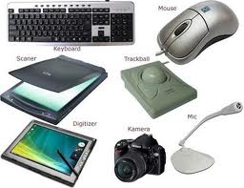
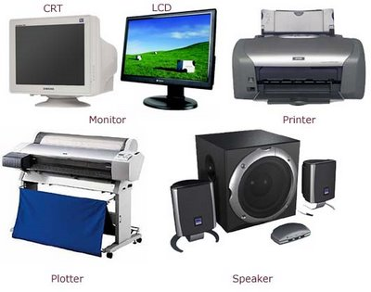
What’s I/O
Input/Output devices
Hardware that interact with user
Input device
Output device
Notes:
Example of I/O devices
Some can serve for both purposes!

Slide 34
OS: I/O management
Computer is multi functional
Many types of applications
Many types of input & output devices
How can an application make use of the I/O devices?
Solution: OS functions as a layer between applications & I/O devices
Notes:
Applications & I/O devices can come from any manufacturer
Not funny if we as developers have to write our own code to access a specific device…
Luckly our OS can handled this

Slide 35


Example: Graphic tablet
Application
Left click at position (20,20)
Operating system
asdmh
Driver
Driver
Yoz$3s
Notes:
Each I/O device speaks it own language so the OS needs to be able to understand this
OS doens’t do this on its own. Little applications called (device)drivers are being used
These drivers translate the instructions from a device to OS understandable instructions
Modern OS usually have drivers installed already and this enbles the plug&play feature of most devices.
The more exotic devices still needs drivers to be installed

Slide 36

Questions?

